Slide 1
Coastal Flooding from Marine Sources
Mr. Fabian Hinds
Deputy Director (Ag)
Coastal Zone Management Unit
8th Floor, Warrens Tower II,
Warrens, St. Michael, BB12001
August 12, 2015
Notes:
This template can be used as a starter file to give updates for project milestones.
Sections
Right-click on a slide to add sections. Sections can help to organize your slides or facilitate collaboration between multiple authors.
Notes
Use the Notes section for delivery notes or to provide additional details for the audience. View these notes in Presentation View during your presentation.
Keep in mind the font size (important for accessibility, visibility, videotaping, and online production)
Coordinated colors
Pay particular attention to the graphs, charts, and text boxes.
Consider that attendees will print in black and white or grayscale. Run a test print to make sure your colors work when printed in pure black and white and grayscale.
Graphics, tables, and graphs
Keep it simple: If possible, use consistent, non-distracting styles and colors.
Label all graphs and tables.

Slide 2
Overview
Introduction
Social & Economic Importance of the Coast
Threats: Coastal Flood Risk
Coastal Flooding: Influential Factors
Factors Controlling Consequences of Flooding
Options
Coastal Flood Hazard Mitigation
Standing Committee on Coastal Hazards
Coastal Infrastructure Programme
Coastal Risk Assessment and Management Programme
Notes:
What is the project about?
Define the goal of this project
Is it similar to projects in the past or is it a new effort?
Define the scope of this project
Is it an independent project or is it related to other projects?
* Note that this slide is not necessary for weekly status meetings

Slide 3
Introduction
Coastal Flooding form Marine Sources Defined:
When sea levels and wave run-up exceed the height of natural beach profile, or artificial sea defense
Result of structural failure of natural or artificial defenses
Coastal flooding – most significant threat to coastal communities
SIDS are particularly vulnerable!
Erosion, climate change & coastal development increases flood risk impacts to human life, economic assets & natural capital/env.
Notes:
* If any of these issues caused a schedule delay or need to be discussed further, include details in next slide.

Slide 4
Social & Economic Importance of the Coast
Approx. 97 km of coastline which crosses 9 of 11 Parishes
Towns (i.e. B’town, H’town, S’town & Oistings) are located adjacent to the sea.
Associated: residential, commercial and industrial development.
Key economic sectors: tourism (leisure), fisheries, ports (air & sea), shipping & residential
Approx. 70% of population lives and/or works within 2-3km of the coastline
Regional SIDS are similarly developed.
Notes:
Duplicate this slide as necessary if there is more than one issue.
This and related slides can be moved to the appendix or hidden if necessary.

Slide 5
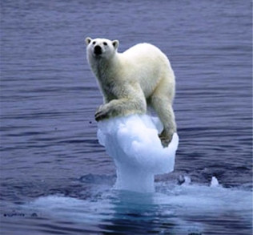
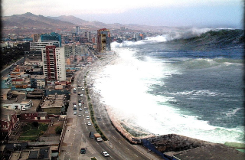
Threats: Coastal Flood Risk
Sea level rise
Coastal erosion : can be difficult to separate from flooding
Structural failure of natural (e.g. reefs, etc.) and artificial (i.e. breakwaters, etc.) defenses
Storm surge
Tsunami

Slide 6
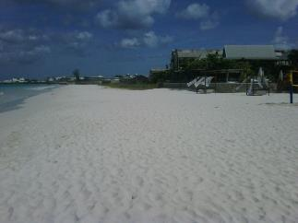
Coastal Flooding: Influential factors
Climate Change – sea level rise , increased storm surge, reef mortality, etc.
Relative land/sea movements
Tectonic activity (sea level rise vs. uplift & tsunami)
Local subsidence vs. uplift
Land slides (tsunami generating)
Sediment transport
Poor design & maintenance of coastal defense structures
Factors can act in combination

Slide 7
Factors Controlling Consequences of Flooding
New assets are placed in flood prone/risk areas
Value of existing assets are increased
Inadequate response plans

Slide 8
Options
Do Nothing
This is not an option given the increasing threat of coastal hazards
Isolated/Localized Flood Defenses
Breakwaters , seawalls & revetments (wave defense)
Groynes (sediment control)
Beach nourishment
Dune building
Preservation & installation of coastal vegetation
Not a comprehensive mitigation option.

Slide 9
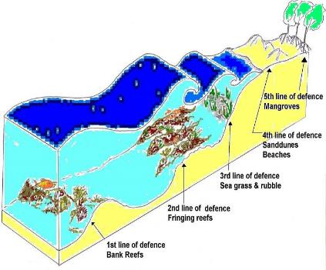
Options: Integrated Management - Coastal Flood Hazard Mitigation
Sustained actions that reduce or eliminate risk.
Flood Risk Management Plans
Prevention
Protection
Preparedness
Emergency Response
Recovery
Institutional efforts – CZMU, DEM, Technical Standing Committee on Coastal Hazards
Capacity building – technology, training, etc.
Legal / Planning
Environmental – ecosystem conservation
Engineering

Slide 10
Standing Committee on Coastal Hazards
DEM/CZMU (Co-Chairs)
Meteorological Services
Barbados Defense Force
Royal Barbados Police Force
Fisheries Division
Telecommunications Unit
Natural Resources Division
Barbados Fire Service
Private sector representation (Bdos Light & Power)
Mandate:
Developing a Master Plan for the national implementation of the Caribbean Tsunamis Warning System (CARTWS)
Identifying national system components of the regional system.
Development of hazard assessment, early warning preparedness, mitigation, public education and awareness.
Guiding the development of a National Coastal Evacuation Plan.
Coordinating private sector involvement

Slide 11
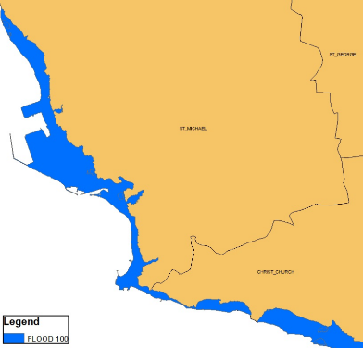
Hazard Maps from Previous Studies
1-in-100 year flood line Hazard map done by Feasibility Studies of Carlisle Bay, Folkestone Park and Marine Reserve, and Harrison's Cave and Associated Sites – Barbados (AXYS Environmental Consultants)
Produced for south and west coast, c.a 1998

Slide 12
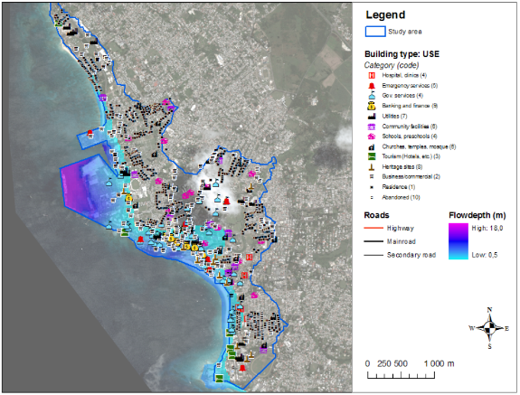
NGI Tsunami Hazard Map
UWI-NGI demonstration project
Methodology for hazard, vulnerability and risk assessment for tsunami scenarios
Produced demonstration hazard maps and loss estimates for Bridgetown
Hazard map can be used for evacuation planning, risk-based urban planning, public education, risk/damage estimates etc.

Slide 13
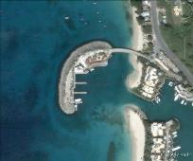
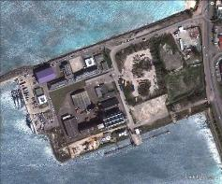
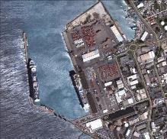
TSCCH Work plan and Activities
Contribute to the Intergovernmental Coordinated Group for Tsunami & Other Coastal Hazards Warning System for the C’bean & Adjacent Regions (ICG/CARIBE EWS)
Establishment of a network of sea level monitoring stations, contributing real time data to the Intergovernmental Oceanographic Commission global network of sea level monitoring
Port St. Charles
Coast Guard Base
Bridgetown Port

Slide 14
CZMU’s Contribution to Disaster Management
Coastal monitoring (sea level, wave climate etc.)
Hazard and risk modelling
NCRIPP (GIS platform)
Coastal Protection
Early warning
Hazard maps and safe zones
Evacuation maps
Location of signage and warning infrastructure

Slide 15
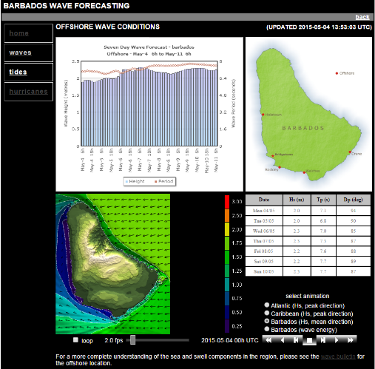
Barbados Wave Forecasting
Services provided by WF Baird & Associates
Automated process for global wave/tide forecasts
Takes global wind data and feeds into numerical wave models at global and regional level
7 day forecast of wave height, period and direction
Critical to CZMU when planning day-to-day coastal construction activities during projects
Also used as early warning for tourism sector and dive operators

Slide 16
Case Study: Coastal Infrastructure Programme (2002 – 2009)
Welches
Holetown
Richard Haynes Boardwalk

Slide 17
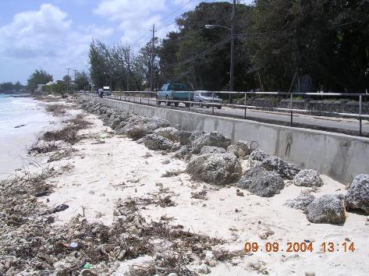
Welches

Slide 18
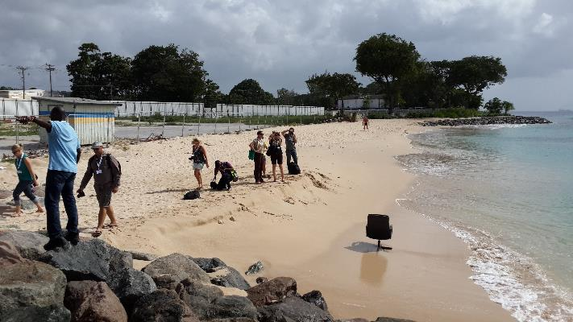
Holetown

Slide 19
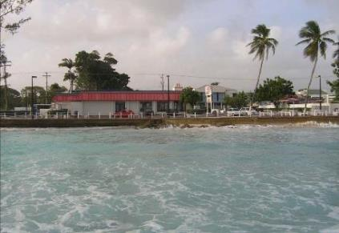
Richard Haynes Boardwalk

Slide 20
Case Study: Coastal Risk Assessment & Management Programme 2011-2018
Climate change adaptation & disaster risk management
Lack of high quality risk data to inform decision making.
Programme objectives are:
Building capacity regarding DRM & CCA
Incorporating DRM and CCA into planning, policy & legislation
Control & monitoring of the CZMA.

Slide 21
Component 1 Coastal Risk Assessment
Baseline studies – nearshore wave climate, LIDAR surveys, geotechnical surveys, shoreline change, etc.
Risk evaluation – hazard & risk maps, risk assessment, etc.
Assess cost of climate change impacts.
National Coastal Risk Information Platform
Training & technology transfer

Slide 22
Component 2 Coastal Infrastructure
Control shoreline erosion – H’town to Heron Bay
Habitat restoration & creation.
Improved public access to beaches.
Enhanced recreational opportunities for tourists and locals.
Water quality improvement – Holetown lagoon
St. Lawrence to Rockley Waterfront Improvement feasibility & design.
Includes ecosystem based non-structural beach stabilization measures, dune stabilization & wetland management.

Slide 23
Component 3 Institutional Sustainability for ICRM
Ensuring sustainability of actions & investments under the CRMP.
Policy/regulatory env. – ICMP update with DRM & CCA, CZMA, regulations, etc.
Institutional capacity building – Training CZ inspectors, etc.
Stakeholder communication & education
Develop cost recovery mechanism

Slide 24
Thank You
Any questions?

